Slide 1
Module 3: Using Files and Directories
Where is my data?
3: Using files and directories
4: Editing text
5: Bash

Slide 2
Contents
From User to Disk
From Pathnames to Disk Blocks
What is a Directory?
Files
Commands
i-nodes
Links
Notes:
In the Linux and Unix world, everything is a seen as a FILE (commands, devices, logs, data and even directories are stored as a file). So, we need to understand what they are and how to use them.

Slide 3
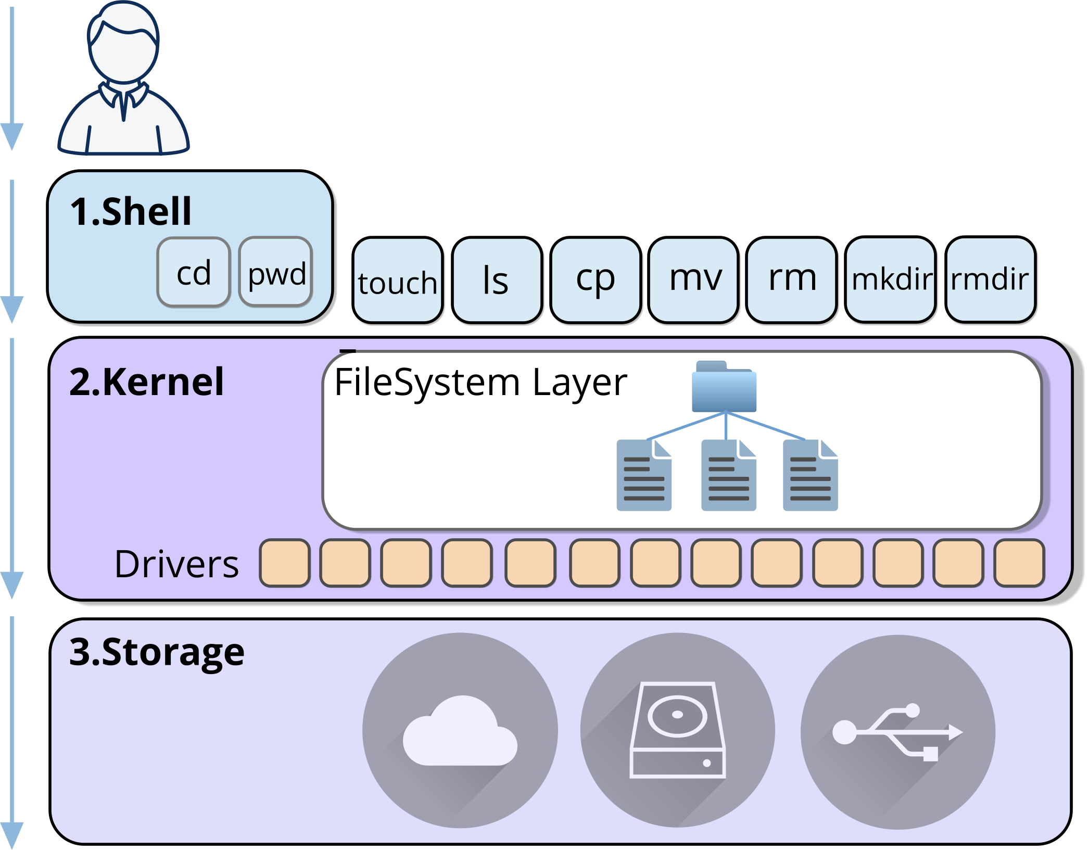
From User to Disk
The shell interprets user commands
The kernel performs the real work
The filesystem layer resolves pathnames
Notes:
When you type a command like cat /etc/passwd, it looks simple.
But the shell itself doesn’t read the file.
It passes the request into the kernel.
Inside the kernel, the filesystem layer resolves the pathname, translates names into inode numbers, and locates the data blocks on disk. Let’s now zoom into that filesystem layer and see what’s really happening when a pathname is resolved.

Slide 4
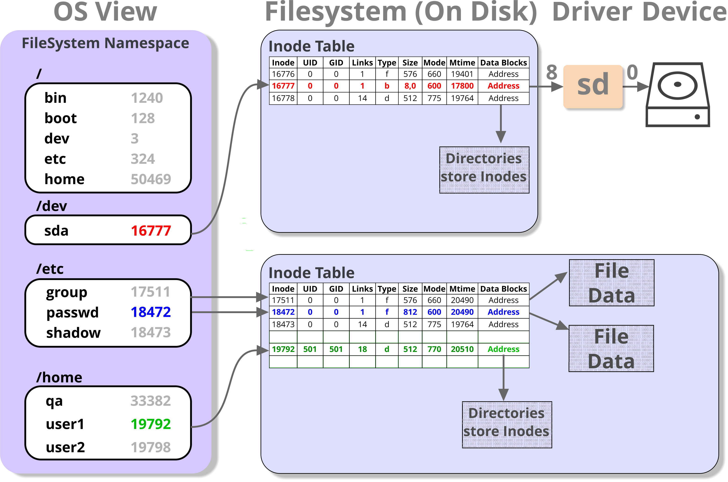
From Pathnames to Disk Blocks
Directories map filenames to inode numbers
Inodes store metadata and block addresses
Data blocks store file contents
Notes:
In Linux, almost everything is treated as a file. This includes regular files, directories, hardware devices, and even certain aspects of system information.
Directories are simply special types of files. Rather than storing user data, they store references to other files and subdirectories, forming the familiar hierarchical filesystem structure.
Every file and directory is represented internally by an inode (index node). The inode stores the file’s metadata, including:
File type (regular file, directory, symbolic link, device, etc.)
Ownership and permissions
File size and timestamps
Pointers to the actual data blocks on disk
Importantly, directories do not store file data. They store mappings between filenames and inode numbers. The inode then points to the file’s data blocks. This design allows Linux to manage files efficiently and consistently.
Even hardware devices and system information are exposed through this same model. For example:/dev/sda represents a disk device/proc/cpuinfo exposes CPU details
Because they appear as files, they can be accessed using the same tools and commands as regular files, providing a uniform interface to the entire system.

Slide 5
Directories

Slide 6
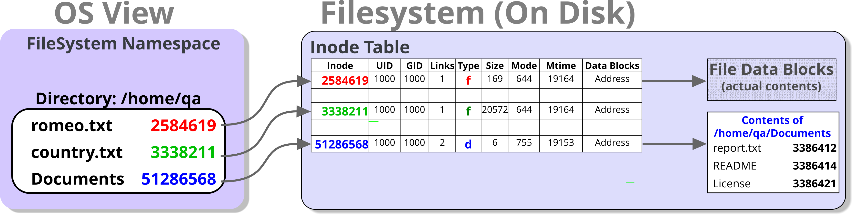
What is a directory?
A directory is a special type of file
It stores filename inode mappings
It does not store file data
Notes:
Data and programs are stored in files. Files are organised into directories, forming a hierarchical (tree-like) structure.
A directory is a special type of file. It does not store file data, it stores filename → inode mappings that describe other files. Directories can contain both files and other directories. This allows the filesystem hierarchy to extend to many levels.
There can be many files and directories within a single directory, and the hierarchy can grow as deep as required by the system and storage capacity.
UNIX/Linux extends the concept of a file further than many operating systems:
Everything is treated as a file.
Physical devices are accessed through special filenames within the filesystem (for example, entries under /dev). In many implementations, system memory, kernel information, and even running processes are also exposed through the filesystem (for example, under /proc and /sys).

Slide 7
Directory names
Directory names may contain any character except /
Some characters (spaces, quotes, wildcards, etc.) can cause issues in the shell
Best practice: use letters, numbers, dot (.), dash (-) and underscore (_)
Maximum length: 255 characters
Dots (.) and underscores (_) are normal characters
Names beginning with a dot (.) are hidden by default
Hidden directories are not shown by ls unless -a is used
255 chars
.this_is_@_very_l0ng_FILE.and.DIR_n4me.pdf
Can use repeated dots and underscores
Use letters, numbers, dot, dash and underscore
Notes:
Directory names may contain any ASCII character except /.
This includes symbols, spaces, tabs, and even non-printing characters. Names that begin with a dot (.), such as .bash_profile or .bashrc, are treated specially. These are hidden by default and are typically used for configuration files.
Although almost any character is technically permitted, some characters can cause problems in the shell and are best avoided.
Examples include:
A hyphen (-) as the first character in a name (may be interpreted as an option)
Shell wildcard characters such as ? and *
Characters with special meaning in the shell: ( ) & [ ] < > |
Spaces and tabs
Non-printing ASCII characters
For clarity and portability, it is best practice to use letters, numbers, dot (.), dash (-) and underscore (_) only.

Slide 8
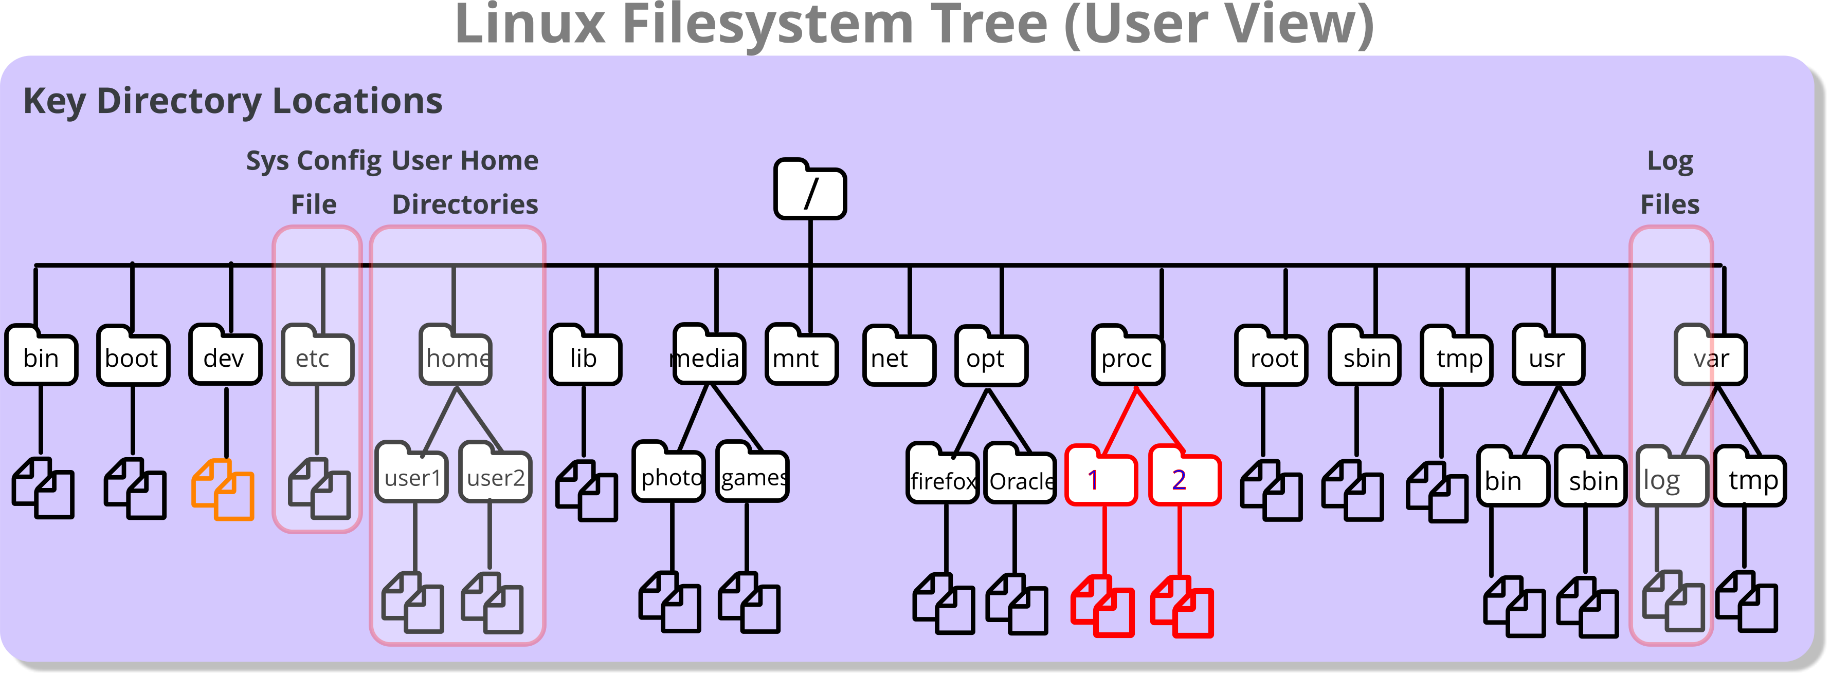
The Linux / Unix filesystem hierarchy
The filesystem appears as a single tree rooted at /
Users navigate this hierarchy using pathnames
Different branches may reside on separate disks or partitions
The layout follows the Linux Filesystem Hierarchy Standard (FHS)
Notes:
The Linux filesystem presents a single unified directory tree rooted at /.
From the user’s perspective, it appears as one continuous hierarchy, even though different parts of that tree may physically reside on separate disks or partitions.
Users navigate this structure using pathnames, either absolute (starting with /) or relative to their current directory.
The layout of the top-level directories follows the Linux Filesystem Hierarchy Standard (FHS), which defines the purpose of directories such as /bin, /etc, /home, /usr, and /var. Some directories, such as /proc, are virtual filesystems that expose kernel and process information rather than storing real files on disk.

Slide 9
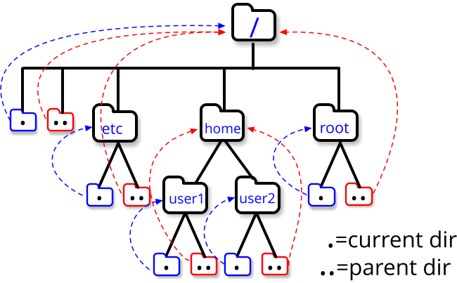
The Special Dot directories
Special dot directories
Single dot . refers to the current directory
Double dot .. refers to the parent directory
These entries exist in every directory
They allow relative navigation within the filesystem
Notes:
Every directory in the Linux file system has two special entries, with names “.” and “..”. These are shorthand ways of referring to:
“this directory”.
“the parent of this directory”.
These shorthands can be used anywhere in a pathname, relative or absolute. They are clearly of most use in relative pathnames, since they allow us to specify paths that traverse upwards through the hierarchy as well as downwards.

Slide 10
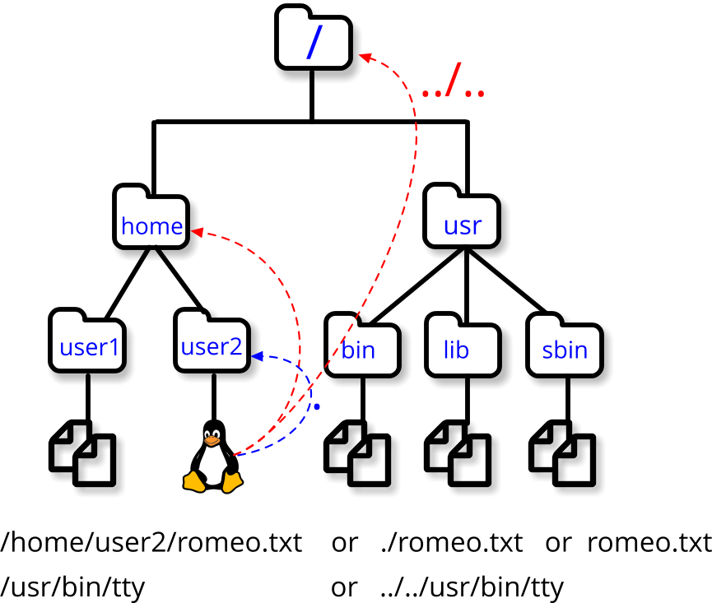
Specifying Pathnames
A pathname identifies the location of a file or directory
Path components are separated by /
Absolute paths begin with / (start from root)
Relative paths begin from the current working directory
Notes:
In this example, the current working directory is /home/user2
From this location - the relative path to /home is:
.. because .. refers to the parent directory.
Therefore, the relative path to /home/user1 is:
../user1 which means “go up one level, then into user1”.
We can also use relative paths to refer to files in the current directory.
For example, the file romeo.txt may be written as:
./romeo.txt Here, . refers to the current directory, so ./romeo.txt explicitly means “the file romeo.txt in this directory”.
The ./ prefix is particularly useful in two situations:
If a filename begins with a minus (-), which would otherwise be interpreted as a command option.
When running an executable file located in the current directory that is not included in the system’s PATH variable.
In those cases, ./ makes it explicit that we want to execute a file in the current directory.

Slide 11
Absolute vs. relative paths
Absolute paths
Always begin with /
Are interpreted from the root directory
Do not depend on your current location
Example: /home/qa/romeo.txt
Relative paths
Do not begin with /
Are interpreted from the current working directory
Change meaning if your location changes
Example: ./romeo.txt
Shortcuts | Meaning
~ | Current user’s home directory
~username | That user’s home directory
~+ | Current directory
~- | Previous directory

Slide 12
Knowledge check
Which of these are relative or absolute paths?
/home/user1
./fred
../../etc/passwd
/var/log
country.txt
~
Notes:
Answers:
Absolute (user1’s home directory0
Relative (fred in the current directory)
Relative (up to directories then down into etc to get to passwd)
Absolute (where the log files are)
Relative (country.txt in the current directory)
Absolute (your home directory)

Slide 13
Working and home directories
The working directory represents your current location in the filesystem
Use the pwd command to display it
It shows the full absolute path of your current directory
Needed when resolving relative pathnames
Use the shell cd command to change working directory:
Every user on the system has a home directory – usually /home/username
It becomes the working directory when the user logs in
Home directory contains user’s own files
Users typically have write permission in their home directory
Also stores user configuration files
Command | Action
cd directory-name | Change to the specified directory
cd .. | Move to the parent directory
cd | Return to the user's home directory
Notes:
Every user has a home directory, which serves several important purposes.
It becomes the working directory when a user logs in to an interactive shell, and it stores user-specific configuration files. These configuration files depend on the applications installed, but many begin with a dot (.) and are therefore hidden by default.
Most of a user’s personal files are typically stored in their home directory. However, a user may work in other directories, provided they have the appropriate permissions. By default, a user’s home directory is protected from access by other users, although this restriction does not apply to the superuser.
Every process running on a user’s behalf has a current working directory. When a user first logs in, this is set to their home directory, and child processes inherit this location. Users can change their working directory using the cd command.
When used without arguments, cd returns the user to their home directory. The cd command (a shell built-in) updates the PWD and OLDPWD environment variables, which may be displayed in the shell prompt to indicate the current location.

Slide 14




Advanced: Pushd and popd
Change directories and change back
pushd and popd manage a directory stack
Allows temporary navigation and easy return
To display those on stack
$ pushd /var/log
/var/log ~
$ pushd /home
/home /var/log ~
$ pushd /etc/init.d
/etc/init.d /home /var/log ~
$ popd
/home /var/log ~
$ popd
/var/log ~
$ popd
~
/etc/init.d
/home
/var/log
$ dirs
/etc/init.d /home /var/log ~
~
Notes:
The BASH (Bourne Again Shell) has numerous built-in commands and features that provide convenient time saving features to the user.
One such feature is the “directory” stack which is accessed by the push, popd and dirs built-in shell commands.
The pushd command can change directory but will also save the directory into a stack (basically a record of directories).
Whilst working in a directory the popd command can be used to change back into the previous working directory by using and removing the last entry on the directory stack.
Continuous use of the popd command changes back to previous entries stored on the stack.
The dirs built-in shell command can be used to display the directories still remaining in the stack.
To display the directory stack one entry per line:- # dirs –p
To clear the directory stack:- # dirs –c

Slide 15
Files

Slide 16

Filenames
Filenames can contain any ASCII characters except /.
Some characters cause shell issues
Best practice: letters, numbers, dot (.), dash (-), underscore (_)
Maximum length: 255 characters
Linux / UNIX file names do not have a true “file type”
A dot (.) is just a character
Extensions are naming conventions only
Names beginning with a dot are hidden
Not shown by ls unless –a is used
255 chars
.this_is_@_very_l0ng_FILE.and.DIR_n4me.pdf
.pdf
Can use repeated dots and underscores
Use letters, numbers, dot, dash and underscore
No FileType!
Notes:
File names in Linux/UNIX can contain any ASCII character except /, which is reserved as the directory separator. This technically includes symbols, spaces, tabs, and even non-printing characters.
Many filenames follow a naming convention where a dot (.) separates the main name from a file extension (for example, report.txt). However, the dot has no special meaning to the filesystem itself — it is simply part of the name.
Files and directories that begin with a dot (for example, .bashrc or .bash_profile) are treated as hidden files and are not shown in directory listings by default.
Although almost any character is permitted, some characters can cause practical problems when used in filenames and are best avoided.
Examples include:
A leading hyphen (-), which may be interpreted as a command option
Wildcard and shell-special characters such as ?, *, (, ), &, [, ], >, <
Spaces and tabs, which require quoting or escaping
Non-printing ASCII characters, which are difficult to see and manage
In practice, it is safest to use letters, numbers, dots (.), dashes (-), and underscores (_).

Slide 17
Commands

Slide 18
Listing files and directories
Option | Action
-l | Long (full) listing
-a | List all files (including ‘dot’ files)
-C/-x | List in columns sorted down/across
-R | Recursive listing of sub-directories
-t | Sort by time rather than name
-d | List directory itself, not its contents
Listing files/directories is achieved with ls
Syntax:
ls | [options] | [file(s)/dir(s)]
Type | Meaning
b | Block
c | Character
l | Symbolic link
d | Directory
- | Plain file
$ ls -l
drwxr-xr-x | 5 | hal9000 | cyber | 168 | 2017-01-28 | 12:10 | Documents
-rw-rw-r-- | 1 | hal9000 | cyber | 677 | 2017-01-29 | 10:21 | file1
drwxr-xr-x | 2 | hal9000 | cyber | 80 | 2017-01-28 | 12:10 | public_html
-rw-r--r-- | 1 | hal9000 | cyber | 237 | 2017-01-30 | 13:22 | script1.sh
Permissions
File ownership
Size in bytes
Date and time
of last modification
Name
Hard link count
Notes:
The example above shows the annotated output from the long directory listing.
File type is described by the very first character in the output of ls -l.
In addition to the plain file, typical types are: directory or symbolic link, other popular types are ‘c’ for character special file (serial device under /dev) or ‘b’ for block special file (storage device under /dev).
The "link count" field reflects the number of filenames that point at the same file number (the internal designation for the file).
File size shows the size of the file in bytes.
The date field is creation date (or modification date if updated).
Finally is the name of the file.

Slide 19

Colors of filenames
Color | Meaning
Uncolored (white) | File; multi-hardlink file
Bold blue | Directory
Bold cyan | Symbolic link
Bold green | Executable file
Bold red | Archive file
Bold magenta | Graphic/video file; socket
Cyan | Audio file
Yellow with black background | Pipe (AKA FIFO)
Bold yellow with black background | Block or character device
Bold red with black background | Orphan symlink; missing file
Uncolored with red background | Set-user-id file
Black with yellow background | Set-group-id file
Black with red background | File with capability
White with blue background | Sticky directory
Blue with green background | Other-writable directory
Black with green background | Sticky and other-writable directory
ls --color

Slide 20
ls -F
ls -F appends symbols to file names.
These symbols show useful information about files.
@ means symbolic link (or that the file has extended attributes).
* means executable.
= means socket.
| means named pipe.
> means door.
/ means directory.

Slide 21
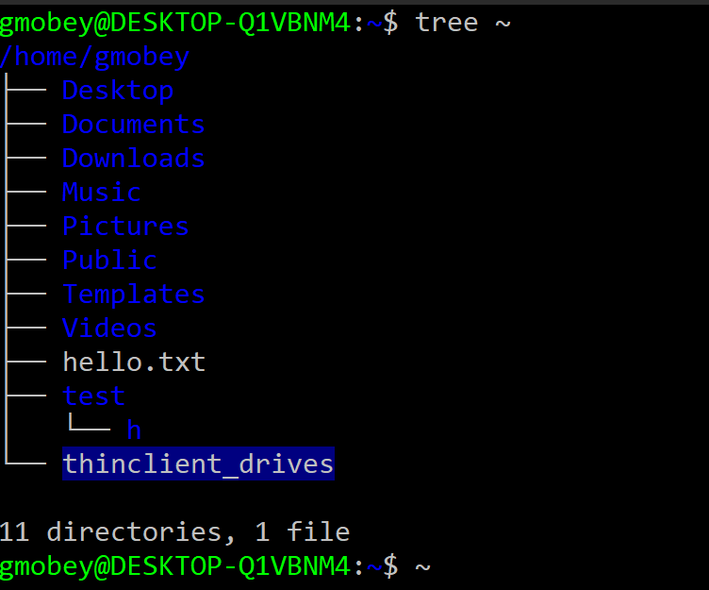
Showing a directory tree
If installed, the tree command shows a directory tree.
Example: tree ~
Notes:
Unlike the ls command the tree command shows the directory structure in a tree-like form.

Slide 22
Lab

Slide 23
Practical exercise 3 – T1 and T2
In the accompanying Exercise Guide

Slide 24
Creating files and directories
Creating an empty file can be achieved with the touch command.
Syntax:
Creating a directory can be achieved with mkdir:
Syntax:
$ touch afilename
mkdir | [-pm] | Dir(s)
Option | Action
-p | Creates the directory and those in its path
-m | Sets the mode (permission)
$ mkdir -p a/dir/path
Notes:
Although the command is designed to change timestamps on a file the touch command will create a file if it does not exist yet.
New directories are created with mkdir specifying the directory to be created (absolute or relative).
The -p option in:
$ mkdir -p a/directory/path
…allows to create the three directories in one go ie: all the directories in the path.
The -m option in:
$ mkdir -m 222 secure-dir
…allows to create a directory with a specified set of permissions (mode).

Slide 25
Copying files and directories
Use the cp to copy file(s) to target file or directory.
If more than one source file is specified, then target must be a directory.
Need write permission on the target file to overwrite it.
cp | [options] | source |  | target
Option | Action
-i | Interactive checking (prompts if target exists)
-r | Copy directories recursively
-f | Forced, no prompt or interaction
cp | [options] | source(s) |  | targetdir
$ cp /etc/passwd a filename
$ cp -i /etc/p* .
$ cp -r . /tmp/myhome
Notes:
Files are copied using the cp command.
If the target is a directory, all source files are copied into that directory.
If the target is a file, a single source file is copied to the specified target.
If the target file already exists, it will be overwritten unless it lacks write permissions. In that case, you must either delete the file or modify its permissions before overwriting. The -f (force) option overrides this behaviour, ensuring the target file is replaced silently.
For example, to copy the /etc/passwd to a file named passwd in the current directory: $ cp /etc/passwd .
And to copy all files from /etc that begin with "p" into the current directory. The -i (interactive) option prompts for confirmation before overwriting an existing file:
$ cp -i /etc/p* .
To copy a directory recursively we must use the –r option. For example, to copy the current directory to /tmp/myhome. This will ensure all sub-directories and files are included: $ cp -r . /tmp/myhome

Slide 26
Renaming (moving) files and directories
Use the mv to copy file(s) to target file or directory.
If more than one source file is specified, then target must be a directory.
The mv command is automatically recursive.
mv | [options] | source |  | target
Option | Action
-i | Interactive checking (prompts if target exists)
-f | Forced, no prompt or interaction
mv | [options] | source(s) |  | targetdir
$ mv passwd /tmp/mypass
$ mv -i file1 /tmp/mypass
mv: replace ‘/tmp/mypass’?
$ mv . /tmp/myhome
Notes:
Files are moved or renamed using the mv command, which changes the full pathname of a file.
If the source and target filenames are in the same directory, the operation is considered a rename.
If the source and target are in different directories, it is considered a move.
If the target file already exists (and is not a directory), it will be overwritten.
To prevent accidental overwriting, use the -i (interactive) option, which prompts for confirmation before replacing an existing file. Even if a file has no write permissions, it can still be overwritten because the operation is handled at the directory level (i.e., the directory’s permissions determine whether a file can be moved or replaced).
To force overwriting without confirmation, use the -f (force) option.

Slide 27
Removing files and directories
Use the rm command to remove files or directories.
To delete an empty directory, you can use rmdir.
rm | [options] | target
Option | Action
-i | Interactive checking (prompts if target exists)
-r | Removes directories recursively
-f | Forced, no prompt or interaction
$ rm mypass
$ rm -i my*
$ rm -r /tmp/myhome
$ rmdir a
rmdir:'a': Directory not empty
$ rm -r a
Notes:
Files are deleted using the rm (remove) command.
Write-protected files: rm prompts for confirmation before deletion.
Interactive deletion: Use the -i option to prompt for confirmation before deleting each file.
Recursive deletion: The -r (recursive) option deletes a directory and all its contents, including subdirectories.
Without -r, rm will not delete directories, even if they are empty
For example, to remove a single file – with no prompting or undo:
$ rm datafile
And to interactively prompt before removing the file:
$ rm -i datafile
And to recursively remove a directory (assuming permissions will allow) and its contents:
$ rm –r Documents

Slide 28
Practical exercise 3 – T3 and T4
In the accompanying Exercise Guide

Slide 29
i-nodes

Slide 30
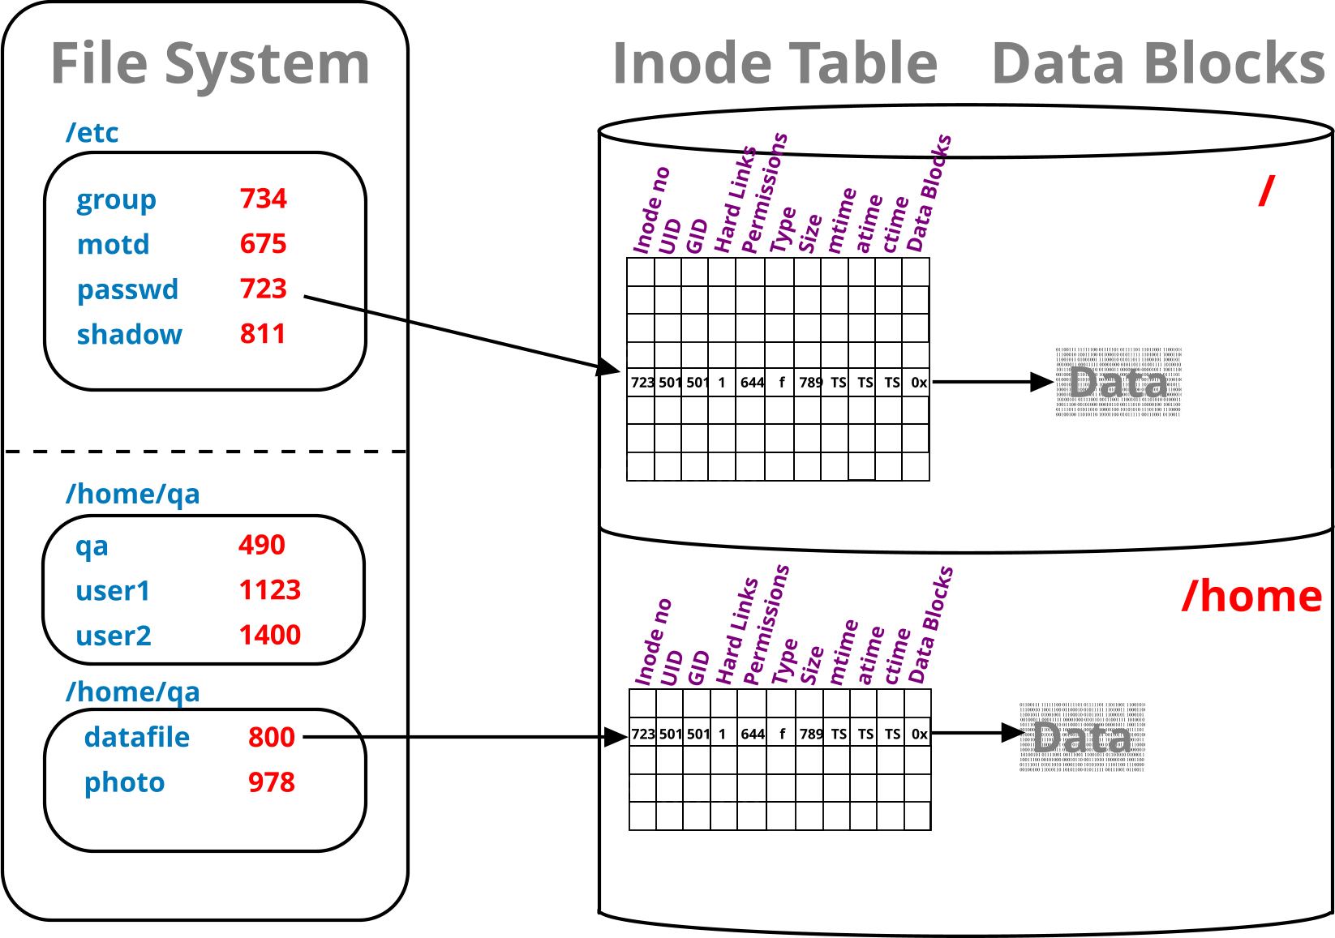
Filesystems, i-node tables, and directories
UNIX and Linux disks are typically partitioned, each containing a file system.
Each partition (filesystem) has its own i-node table.
i-nodes point to the data-blocks.
Directories map filenames to i-node numbers.
Notes:
Linux and Unix disks are often partitioned (for ease of maintenance and a choice of filesystem types).
Each partition is high-level formatted (process that applies a filesystem).
Both Linux and UNIX supports several different types of filesystem
On Unix ufs, jfs and vxfs are the most popular ones, whereas on Linux we use the family of ext? file system types (ext2, ext3 and ext4) as well as xfs, zfs, gvfs, reiserfs and btrfs.
The resulting filesystem has its own i-node table, which in turn, contains one record (i-node) for each file or directory on this filesystem.
Conversely, each file has one allocated i-node containing all the file information (including pointers to the file or directory data blocks).
The only file attribute not stored on the i-node is its name.
The filename is stored in the directory containing the file.
In other words, directories simply relate names to i-node numbers.

Slide 31
Looking inside i-nodes
I-nodes store most file attributes, Except for the file name, which is stored in a directory.
i-node can be explored with the stat command…
…or via ls using the –i and –l switches.
i-node numbers are unique within a partition / filesystem.
$ stat script1.bash
File: script1.bash
Size: 237 Blocks: 8 IO Blocks: 4096 regular file
Device: 802h/2050d Inode: 77909 Links: 1
Access: (0755/-rwxr-xr-x) Uid: (501/hal9000) Gid: (500/cyber)
Access: 2000-01-30 13:22:36.000000000 +0000
Modify: 2000-01-30 13:22:36.000000000 +0000
Change: 2000-01-30 13:22:36.000000000 +0000
$ ls -li script1.bash
77909 –rwxr-xr-x. 1 hal90000 cyber 237 Jan 30 2000 script1.bash
Notes:
The stat command, like ls -l, provides access to the inode table contents. However, stat offers more detailed and comprehensive information than ls, including lower-level logical block details and additional file attributes.
One of the key advantages of stat is its ability to display all three timestamps maintained for each file and directory:
Access time (atime): Records when the file was last opened for reading.
Modification time (mtime): Indicates when the file's contents were last changed.
Change time (ctime): Tracks when the inode itself was modified, rather than the file content. This occurs when file attributes such as ownership, permissions, or size are altered.
By using stat, users can gain deeper insight into file activity and system changes beyond what ls -l provides.

Slide 32
Links

Slide 33
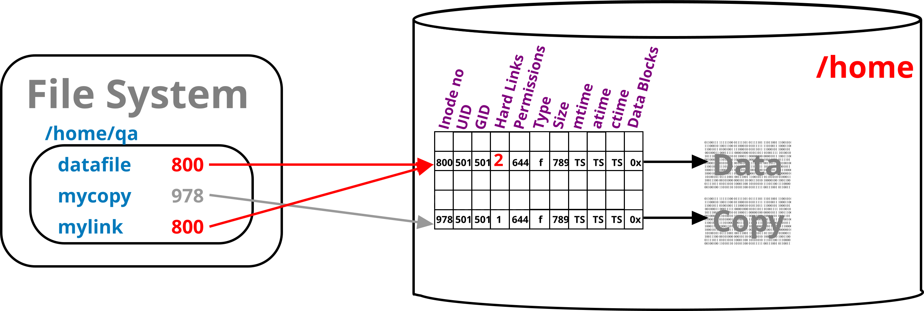
Hard links
Directories map file names to i-node numbers.
Each of these count towards a file’s link count.
Stored in the file’s metadata/i-node
Effectively a count of the names a file has
This is called a hard link.
The i-node is partition bound.
And thus, the hard link is too
Directories naturally have a higher link count.
Three plus one per directory within it
Manually created hard links can only refer to files.
$ cp datafile mycopy
$ ln datafile mylink
$ ls -li datafile mylink mycopy
800 –rwxr-xr-x. 2 qa qa 1402 Jan 30 12:24 datafile
978 –rwxr-xr-x. 1 qa qa 1402 Jan 30 12:28 datafile
800 –rwxr-xr-x. 2 qa qa 1402 Jan 30 12:24 mylink
Notes:
All UNIX and Linux filesystems, implement the concept of a link, which mean that several names can be associated with one i-node number.
All UNIX and Linux filesystems support the concept of links, allowing multiple filenames to be associated with a single inode.
A hard link is essentially a directory entry that points to an existing inode. Since all links share the same inode, they reference the same data on disk. This means changes made to a file through one hard link are immediately reflected in all other hard links to that file.
When a hard link is removed, the system decreases the link count for the associated inode. If the link count reaches zero, meaning no directory entries reference the inode anymore, the system deallocates the inode and frees the storage space. This is why the command to remove a file is called rm (remove) rather than delete, as files persist until all links to them are removed.
In the example on the slide, the file mycopy is a copy of datafile and is assigned a new i-node and its own data blocks. Whereas the mylink file is created using the ln command and the file system assigns the same i-node as datafile and therefore sharing the same attributes and data. The file system will increment the hard link count by 1.

Slide 34
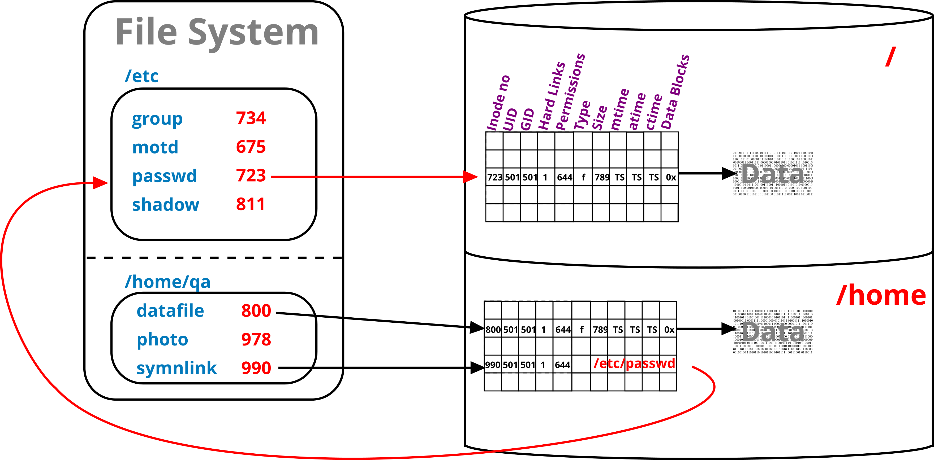
Symbolic links
A special file that refers to (points to) another by its path
Thus, can span partitions / file systems
Relative or full paths can be used
Full path is recommended
$ ln -s datafile softlink
$ ls -li datafile softlink
800 –rwxr-xr-x. 2 qa qa 1402 Jan 30 12:24 datafile
990 lrwxrwxrwx. 2 qa qa 8 Jan 30 13:21 softlink -> datafile
Notes:
Hard links have two main limitations: they cannot be created for directories (as this would cause loops in the filesystem hierarchy) and they cannot span across different filesystem partitions (since each partition has its own separate inode table).
To overcome these restrictions, Linux provides symbolic links. Unlike hard links, which share the same inode as the target file, symbolic links store the pathname of the target file within their own inode. This behaviour is similar to shortcuts in Windows.
Since symbolic links reference pathnames rather than inodes, they can link to both files and directories and can span across different filesystem partitions. They also consume minimal disk space, typically requiring only an inode entry and, for longer pathnames, additional data blocks. However, there is a slight performance overhead, as the kernel must resolve the stored pathname back into the filesystem to locate the actual file.

Slide 35
Hard links and symbolic links compared
Hard links translate file names to i-node numbers
Pointing to entries in the i-node table
Symbolic links refer to where a file is / was
The path can be relative or, preferably absolute
directory
i-node table
Data-blocks
file1 (136220)
file2 (136220)
file3 (136224)
136220
136324
The file’s data
Path to file ->

Slide 36
Creating links
(Use ls command to confirm changes.)
The file being linked to, must exist, at the time the link is created.
Remove links with rm.
A file is deleted when the last hard link is removed.
ln |  | source |  | target
ln | -s | source |  | targetpath
$ ln file1 file2
$ ln -s file1 file3
$ ls -il file[1-3]
77642 -rw-r--r-- 2 user1 other 243 ... file1
77642 -rw-r--r-- 2 user1 other 243 ... file2
77645 lrwxrwxrwx 1 user1 other 5 ... file3 --> file1
$ ls -ilL file3
77642 -rw-r--r-- 2 user1 other 243 ... File3
Notes:
The example above illustrates the creation of two link files: a hard link, and a symbolic link.
Hard link is just another name pointing at the same i-node entry as the original filename.
The moment the hard link has been created, the idea of an original and new name ceases to exist.
Both names can be used to perform all allowed operations on the file. However, neither of the names can be moved into a different filesystem without destroying the link between them.
The symbolic link points at the logical name, rather than physical address of the file, it can be moved about without breaking the connection with the original.
However, if the “original” file is removed, the symbolic link breaks, and will report that file does not exist when you try to access it.

Slide 37
Review and lab

Slide 38
Review questions
What is the basic difference between a hard link and a symbolic links?
What is meant by a recursive operation on a directory?
What is the purpose of the /etc directory?
What is an absolute (full) pathname?
Which two commands allow to remove directories?
Scenario: You created a symbolic link file called symfile to a text (source) file. Subsequently, you have removed the source file. What will happen if you run cat symfile command?
Notes:
Hard link is an additional entry in a directory, pointing at the same i-node number. Symbolic link is a file in its own right, with the contents set to the name (logical address) of the original file.
Recursive means a repetitive application of a command; it usually means that you apply a command to the given directory and its entire content (the command will descend to the bottom of the directory branch).
It contains system configuration files.
A location of a file referenced to the root of the filesystem (/). For example: /etc/default/sudo is an absolute (full) pathname, whereas etc/default/sudo is a relative pathname (relative to your current location)
rmdir can remove a directory (although it can only handle empty ones) rm –r can also remove a directory, complete with its content
You will get an error message saying: “cat: symfile: No such file or directory”.

Slide 39
Practical exercise 3 – T5
In the accompanying Exercise Guide

Slide 40
Summary
Linux directory layout follows FHS.
Data is stored in files; files are grouped in directories
The home directory is where you are after logging in
Absolute pathname starts with the leading '/‘
Relative pathname is with respect to the current directory
Files and directories can be managed with basic tools.
Files can be accessed through alternative names (links).
Hard link, within the same filesystem
Symbolic link, contains logical address of the original
Files have attributes.
Stored on disk, in i-node table

